Slide 1
YOUR GREEN & HEALTHY HOME
Our resident guide to a healthy home, a healthy community and a healthy YOU.
Notes:
Cover page.
Please refer to the Resident Manual Directions on how to use this reference template on your own projects.

Slide 2
TABLE OF CONTENTS
IMPORTANT PHONE NUMBERS 00
WELCOME FROM THE DIRECTOR 00
LIFESTYLE 00
COMMUNITY CONNECTION 00
BEATHE EASY WITH CLEANER AIR 00
SMOKING POLICY & SUPPORT 00
ENERGY: COMFORT & EFFICIENCY 00
WATER SMART 00
RECYCLING & WASTE MANAGEMENT 00
GREEN CLEANING 00
PEST MANAGEMENT 00
EMERGENCY PLAN 00
EXTERIOR SITE MAINTENANCE 00
ROUTINE MAINTENANCE PLAN 00
LOCATION OF SYSTEM TURN-OFFS 00
BUILDING POLICIES 00
This document was developed by Group14 Engineering and Red Thread Creative Group
on behalf of Enterprise Green Communities.
ENTERPRISE RESIDENT HANDBOOK • 2
Notes:
How to use this page:
Determine who will be included on the “Welcome” page of the manual and adjust the red text as needed.
Determine if you’d like to include the Building Policies in this manual or not. Be sure to delete the page in this booklet under the Maintenance section as well as the text on this slide if you are not going to include them.
Be sure to update the page numbers. As you may add or delete pages within this manual as they are relevant to your project, you will want to update the page numbers in the right hand column so that it is relevant to your project.

Slide 3
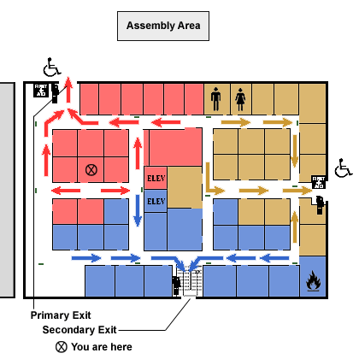
SERVICE / SUPPORT / EMERGENCY
If you are experiencing a health or safety emergency DIAL 911
Building Management 000.000.0000
Building Maintenance 000.000.0000
Police Non-Emergency Line 000.000.0000
City Information 000.000.0000 / www.city.gov
Regional Transit 000.000.0000 / www.transit.gov
ENTERPRISE RESIDENT HANDBOOK • 3
Notes:
How to use this page:
Update the map and phone numbers with relevant local and building-specific emergency information.
Consider including the location of fire alarms, fire extinguishers, and senior designated waiting areas on the map if in a mid/high rise.
Consider getting input from: Property Management

Slide 4

WELCOME TO OUR COMMUNITY!
The purpose of this resident manual is to provide you with the tools, information and resources to help you create and maintain a green and healthy home, community, and lifestyle.
THIS MANUAL
Provides guidance on maintaining and operating your home
Offers tips and suggestions for creating and maintaining a healthy and green lifestyle
Outlines building policies and procedures
Provides maps of the building and nearby amenities, including public transportation access and bike trails
And much more!
Please refer to your lease agreement for specifics on building policies and regulations..
Thank you and welcome home!
<INSERT SIGNATURE HERE>
First Last name
Title
[INSERT LOGO HERE]
ENTERPRISE RESIDENT HANDBOOK • 4
Notes:
How to use this page:
Substitute the photo with the individual who is “signing” the manual and providing the welcome, this may be the on-site property manager or the organization’s executive director.
Fill out the information about that individual, including the signature, first and last name, and title
Insert the organizations logo

Slide 5

WHAT TO EXPECT FROM YOUR HOME
This is an Enterprise Green Communities Building.
Enterprise Green Communities is the first national green building program developed for affordable housing. The program was developed by Enterprise Community Partners to provide a clear, cost effective framework for all kinds of affordable housing: new construction and rehabs in multifamily, as well as single family buildings.
Because there are many ways to build green, Enterprise Green Communities provides developers with guidelines to ensure the homes built are healthy and sustainable for their tenants. To achieve EGC Certification, a project needs to earn points in eight categories:
Integrative Design
Location and Neighborhood Fabric
Site Improvements
Water
Operating Energy
Materials
Healthy Living Environment
Operations, Maintenance, and Resident Engagement
To learn more about the Enterprise Green Communities rating system, please visit www.enterprisecommunity.org/green
ENTERPRISE RESIDENT HANDBOOK • 5
Notes:
How to use this page:
No adjustment is needed

Slide 6
Enterprise Green Communities Checklist
Below are the criteria that this project complied with to earn Enterprise Green Communities Certification
[Input criteria here]
This document was developed by Group14 Engineering and Red Thread Creative Group
on behalf of Enterprise Green Communities.
ENTERPRISE RESIDENT HANDBOOK • 6
Notes:
How to use this page:
Include the spreadsheet from the online portal of the optional and mandatory criteria that is available for export in the online portal

Slide 7
WHAT A “GREEN” HOME MEANS TO YOU
While your new home may look just like what you have seen in other places you’ve lived, it is designed with high standards and the intent to reduce environmental impact and improve human health.
You are living in a home that is comfortable, energy efficient, affordable to maintain, and long-lasting. Your home:
Social Equality
Improves your health and wellbeing
Improves air quality and reduce toxins
Increases access to basic amenities and alternate transportation
Enhances comfort and control in the home
Economic
Reduces the cost to operate the building
Lowers utility bills
Increases occupancy of the homes
Improves performance and durability of the equipment
Environmental
Protects nature, wildlife and its diversity
Provides better air and water quality
Conserves natural resources
This guide will help to explain the special features in your home that will protect your health and well-being while also giving you actionable tips and information to live a green, healthy, and thriving lifestyle.
Use the icons at the bottom of each page to navigate the guide.
ENTERPRISE RESIDENT HANDBOOK • 7
Notes:
How to use this page:
No adjustment is needed, but you may want to add or take away bullet points as they resonate with your residents.

Slide 8
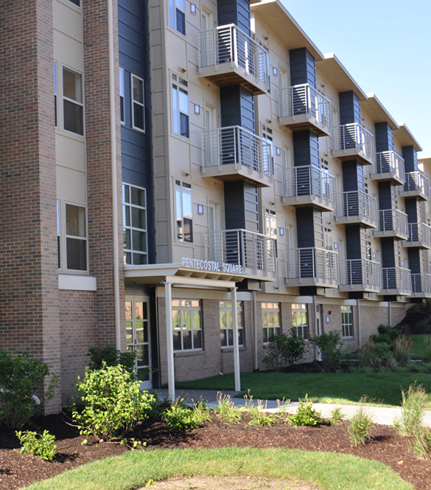
BUILDING FEATURES
Low or non-toxic volatile organic compounds (VOCs) in all paints, coatings, sealants, adhesives, and flooring
This means cleaner air for you! It is proven that these materials help reduce health problems associated with asthma and other chronic issues.
Plumbing fixtures that use less water than traditional fixtures
These fixtures will reduce water consumption and help our state and country through drought struggles.
Lighting and heating equipment that improves comfort and controllability
You will be thankful for easy-to-use and efficient fixtures and equipment that will improve your comfort at home and reduce harmful emissions.
Designed for resiliency to help withstand any unexpected weather events or loss of power.
ENTERPRISE RESIDENT HANDBOOK • 8
Notes:
How to use this page:
You may swap out the photo with an actual exterior shot from your home or building if desired. Only replace the photo if you have a high quality, high resolution image. Otherwise, this image can remain.
You may also change and/or add other building highlights here, such as: LEED ND neighborhood certification, PV or Solar Hot Water system, recycled or regional materials, support for local economy, etc…

Slide 9

Notes:
How to use this page:
- No adjustment needed

Slide 10
LIFESTYLE
LIVE GREENER
There is a strong connection between your personal lifestyle choices and the health of the environment. In taking care of your health you are taking care of the earth (and vice versa).
LIVE GREENER
1. Buy Local
Buying local reduces the emissions required to get goods to consumers while supporting the local economy and providing you with fresher, healthier foods and products.
3. Stay Active
Use the stairs, ride your bike, go for a walk. Staying active greatly decreases risk for chronic disease, obesity, and health disparities. It also keeps you living longer and decreases your cost of healthcare.
2. Use Green Cleaning Products
Choose non-toxic, zero VOC, biodegradable products in recycled packaging or use homemade substitutes when possible. This is better for your family’s health, your wallet, and the environment.
4. Use Public Transportation
Public Transportation cuts down on your environmental footprint, so does carpooling! Find out more information on the public transportation in your area in this guide.
The more connections we have to the people and places around our home, the healthier and happier we are and the longer we live. – Robert Putman, Harvard University Professor
ENTERPRISE RESIDENT HANDBOOK • 10
Notes:
How to use this page:
No adjustment needed

Slide 11
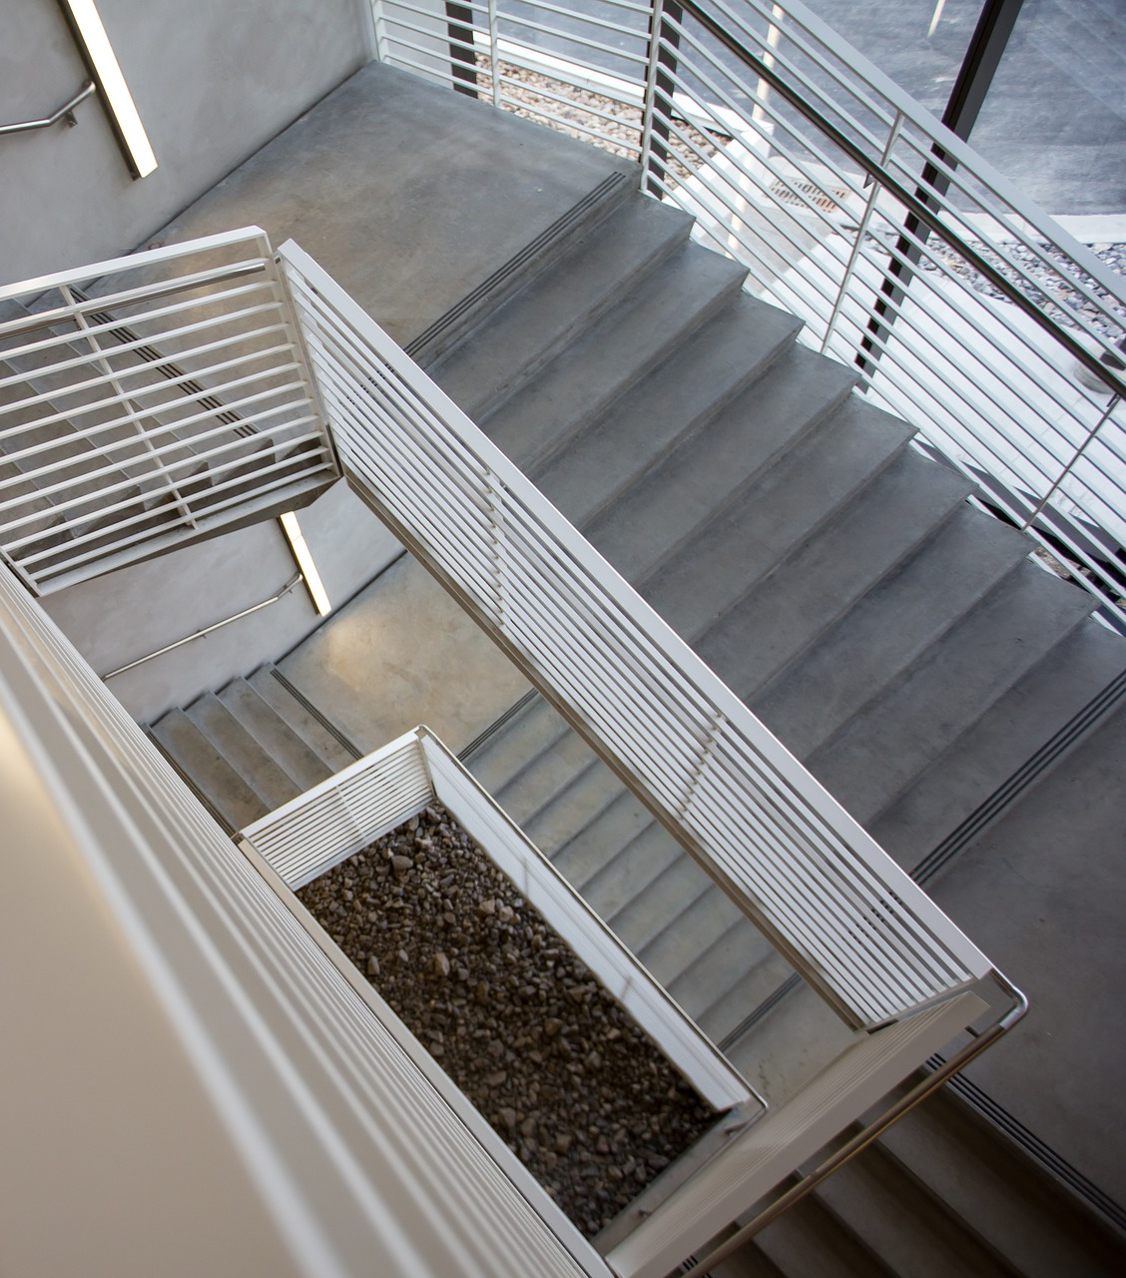
LIFESTYLE
STAYING ACTIVE
This building has been designed with your fitness and health in mind. Several amenities are provided to ensure you can be active.
Stairwells Gone are the days of boring, poorly lit stairwells. The stairs in this building have natural light and artwork to encourage residents to use the stairs.
Fitness Area The fitness area is located here and contains XXX equipment.
Hours: XXX
Bike Storage and Repair Bike storage is located here. The bike maintenance station is located here. For assistance, contact Management.
Activity Space On site there is a dedicated recreation space for adults and children. This area is intended to encourage residents to connect and be active. Add detail as needed.
Hours: XXX
ENTERPRISE RESIDENT HANDBOOK • 11
Notes:
How to use this page:
Add and/or take away from the information provided here as needed. Be sure to call out the location and specific hours of operation to these features as applicable.
Insert a picture for the background that is particular to your building if you have a high-quality / high-resolution image. If no image is available, you can continue to use this background image.
Consider getting input from: the Service Coordinator and/or Property Management on the hours of operation as well as available building features and activities

Slide 12

LIFESTYLE
COMMUNITY GARDEN
Plot use and Maintenance
XXX
Harvesting
XXX
Irrigation
XXX
Want to get involved?
Contact: XXX
COMMUNITY SERVICES
Medical Services
XXX
Computer Lab
XXX
Community Kitchen
XXX
On-Site Activities
XXX
ENTERPRISE RESIDENT HANDBOOK • 12
Notes:
How to use this page:
If there is a community garden on site, insert images as well as details regarding garden use – such as policies, programs, guidelines, harvesting, proper usage, irrigation needs, etc. If there is a garden club, make note of how to get involved and who to contact. If there is a resident leader for the garden this is ideal.
If there are community services, such as those listed in the slides or others, include them here.
If there is no community garden on site or community service activities, you can remove this page.
If the space provided on this page is not enough to outline all of the community garden and community services information consider adding an additional page, by right clicking on the side bar (page 11) → duplicate slide. Then you may edit as needed.
Consider getting input from: the Service Coordinator and/or Property Management on the details of the garden and community services

Slide 13
COMMUNITY CONNECTION
TRANSPORTATION
Car Share
Car share information can be found here.
Carpooling
Carpool information can be found here.
Bicycles
Bicycle storage/racks can be found here.
Walking
Trial access and information is available here.
Bus
Bus information is available here.
Light Rail / Train
Rail information is available here.
ENTERPRISE RESIDENT HANDBOOK • 13
Notes:
How to use this page:
Fill out the “here” of each of the modes of transportation and provide more information as needed.
Consider getting input from: Service Coordinator and/or your local public transportation organization.
The slide will require doing a little background research into car share options as well as bicycle and walking routes (reference www.walkscore.com or google maps) and the city’s public transportation networks.

Slide 14
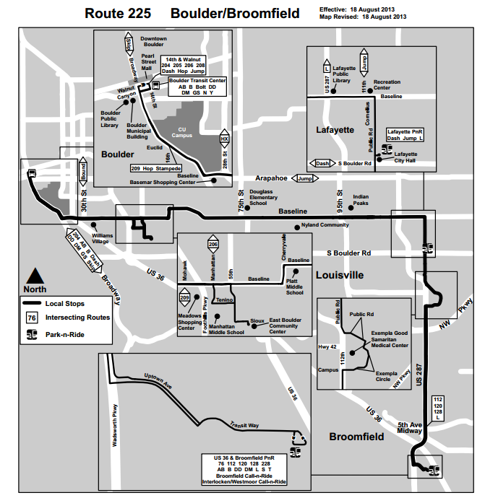

COMMUNITY CONNECTION
TRANSPORTATION
XXX Bus System
Insert Web link
ENTERPRISE RESIDENT HANDBOOK • 14
Notes:
How to use this page:
Update the map with a relevant transit map to your location – if there are more than one nearby routes, you can add pages (right click, select “duplicate slide").
Update the bus system program (currently states “Bus System”) and link to schedules. It is preferable not to actually include the schedules as these may change. But, it is recommended that you have updated public transportation system schedules and maps located in your property management office.
Include an icon of your building’s location on the map so that people have reference point.

Slide 15
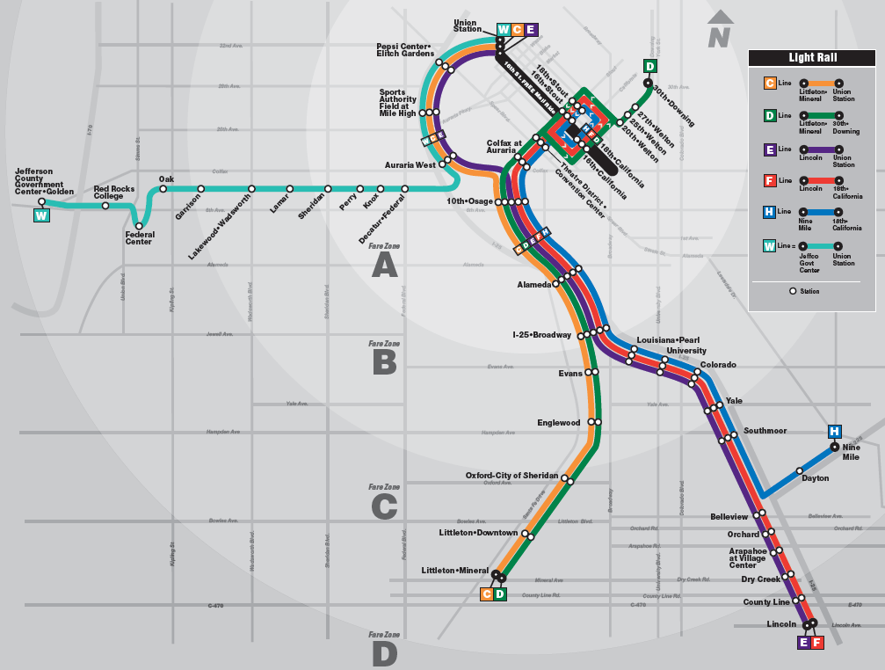
COMMUNITY CONNECTION
TRANSPORTATION
XXX Light Rail System
Insert Web link
ENTERPRISE RESIDENT HANDBOOK • 15
Notes:
How to use this page:
Update the map with a relevant transit map to your location – if there are more than one nearby routes, you can add pages (right click, select “duplicate slide").
Update the light rail / train system program (currently states “Light Rail System”) and link to schedules. It is preferable not to actually include the schedules as these may change. But, it is recommended that you have updated public transportation system schedules and maps located in your property management office.
Include an icon of your building’s location on the map so that people have reference point.

Slide 16
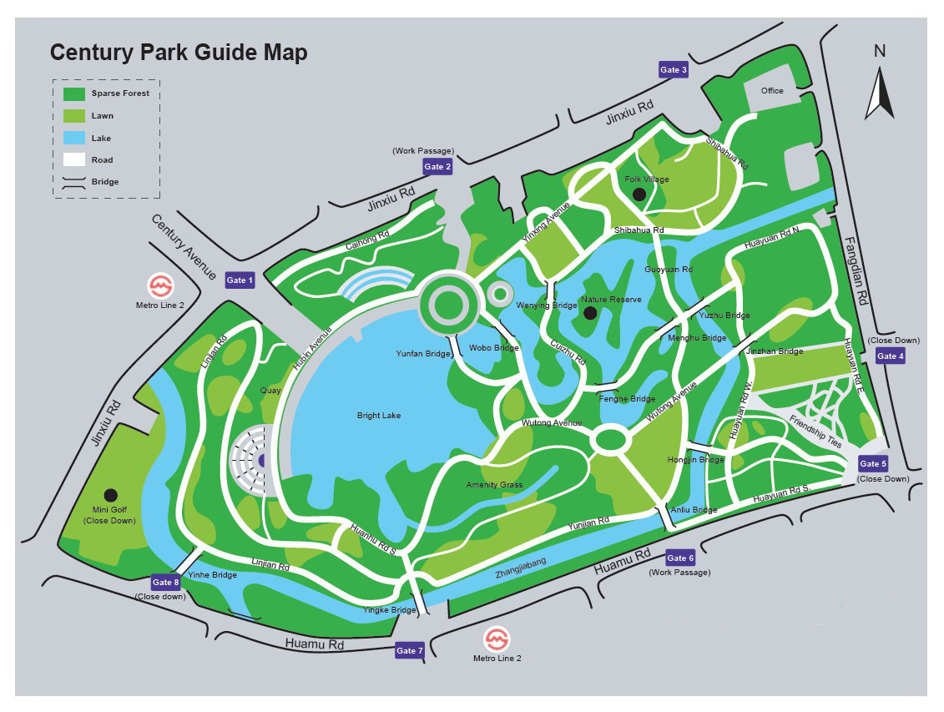
COMMUNITY CONNECTION
PARKS AND PLAYGROUNDS
Local parks and park access information…
ENTERPRISE RESIDENT HANDBOOK • 16
Notes:
How to use this page:
Remove the sample map and insert map(s) specific to your building, if possible, provide safe walking routes on the map. Safe walking routes can be found on google maps and walkscore.com.
Have an icon of your location on the maps so that residents have a reference points.
Consider getting input from: the City’s Recreation Department. They may be able to make a map that is specific to the parks and playgrounds near your building.

Slide 17
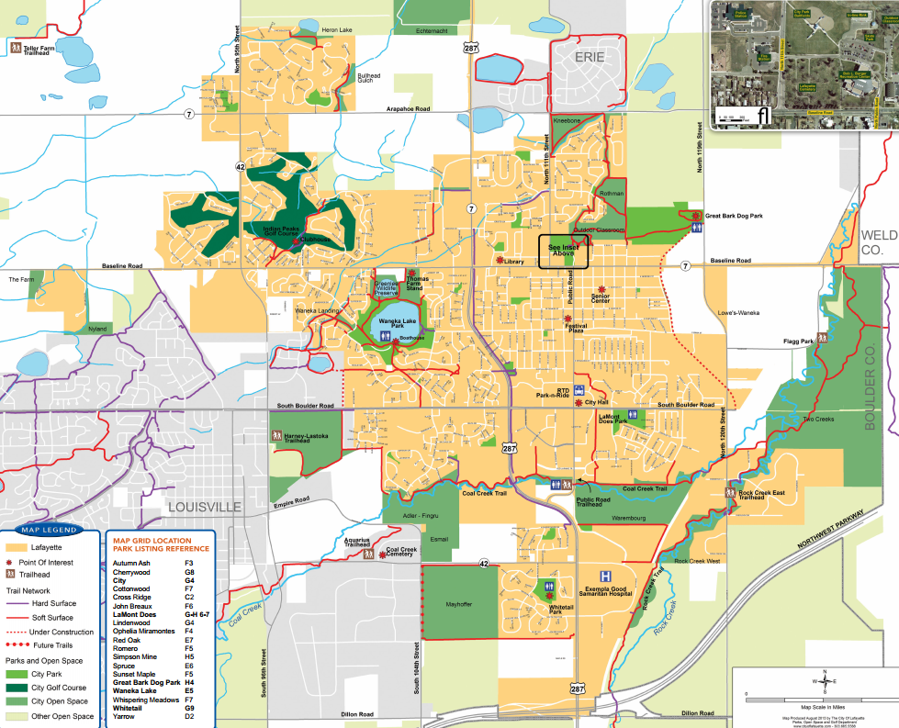
COMMUNITY CONNECTION
OPEN SPACE
Open space access information…
ENTERPRISE RESIDENT HANDBOOK • 17
Notes:
How to use this page:
Remove the template map and insert map(s) specific to your region.
Have an icon of your location on the maps so that residents have a reference points.
Consider getting input from: the City’s Recreation Department. They may be able to make a map that is specific to the open space in your region.
The open space map is intended to provide residents with locations that are larger in scale and reflect native terrain (i.e. nature) oppose to the “parks and playgrounds” slide.

Slide 18
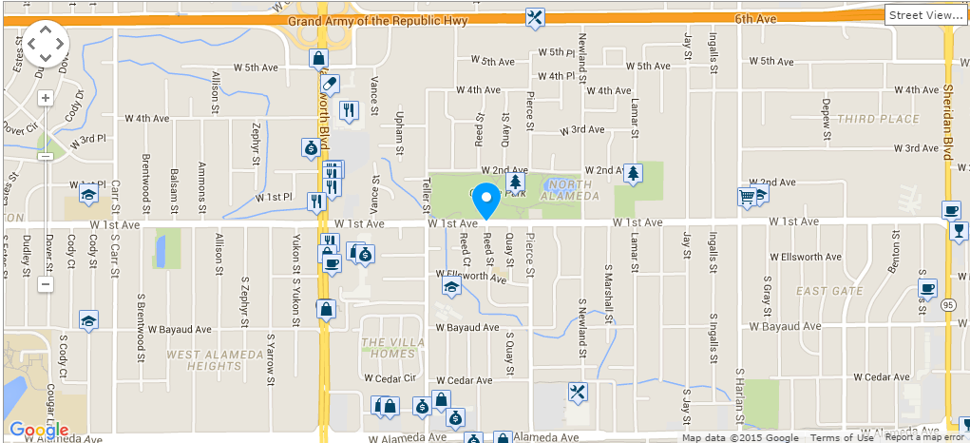
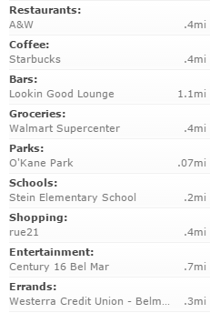
COMMUNITY CONNECTION
NEARBY AMENITIES
Nearby amenity information…
ENTERPRISE RESIDENT HANDBOOK • 18
Notes:
How to use this page:
Remove the sample map and insert map(s) specific to your building, if possible, provide safe walking routes on the map. Safe walking routes can be found on google maps and walkscore.com.
Have an icon of your location on the maps so that residents have a reference points.
In order to find nearby amenities, reference www.walkscore.com and highlight those amenities that are within walking distance, most notably: fresh/nutritious food options, grocery stores, schools, daycare services, and pharmacies.

Slide 19
BREATHE EASY
AVOID ASTHMA AND ALLERGY TRIGGERS
Help keep your home clear of these common asthma
and allergy triggers.
PESTS
MOLD & MOISTURE
TOBACCO SMOKE
DUST MITES
Report Issues
Report problems to management as soon as possible (Insert phone number).
Good Housekeeping
Be sure to: clean up food waste daily, avoid collecting boxes/papers/magazines, check cupboards and corners for pests and mold, maintain a regular cleaning routine.
Treat Pets
Have pets treated for fleas and other pests yearly.
No Pesticide Foggers
Avoid using foggers as they are often ineffective and contain products that are harmful to your health.
Report Leaks
Report plumbing/roof/toilet leaks to management as soon as possible (Phone number). A small leak can turn into a big problem quickly.
Exhaust Fans
Use the exhaust fans in your kitchen and bathroom to avoid mold and moisture damage. Clean regularly to avoid buildup of dust.
Smoking
Smoke at least 25 feet away from the building.
If you or a family member is experiencing persistent hives, rash, or breathing issues, contact your health care provider.
ENTERPRISE RESIDENT HANDBOOK • 19
Notes:
How to use this page:
Insert relevant numbers as needed.
Review the information and ensure it is applicable to your building and policies.
Consider getting input from: Property Management and Maintenance Staff

Slide 20

SMOKE FREE
SMOKING POLICY & SUPPORT
Briefly state where smoking is allowed / not allowed on the property.
Why is Smoke Free Housing Good?
Smoking is the #1 cause of lung cancer and shortening of lives
Smoking is the #1 cause of severe ear aches and asthma in children
Secondhand smoke is the third leading cause of preventable death
Secondhand smoke can cause Sudden Infant Death Syndrome (SIDS) in babies
Limiting exposure to smoke improves your chances of avoiding heart disease and other problems
Smoking poses a fire hazard and damages interior finishes
Resident Role
To be respectful to others and ensure the health and wellbeing of all residents, please smoke outside at least 25 feet from windows and doors
To keep our grounds clean and safe, please use an ashtray and throw away butts properly
If you want to quit smoking, XXX programs offer help. Contact XXX for more information.
ENTERPRISE RESIDENT HANDBOOK • 20
Notes:
How to use this page:
State the smoking policy and where residents are allowed or not allowed to smoke and where.
If there is a cessation program already in place, provide details and contact information. Many local pharmacies (such as CVS and Rite Aid) also have cessation programs in place. Consider reaching out to local establishments to see about availability.
Consider getting input from: Property Management and either your organization’s smoking cessation program director or a local organization that assists in smoking cessation.

Slide 21
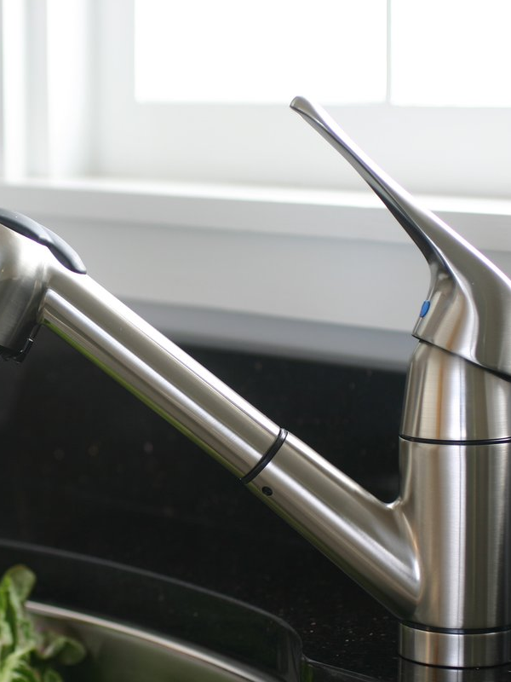

Slide 22
ENERGY
COMFORT & EFFICIENCY
Reducing your ENERGY consumption provides the greatest opportunity to positively affect the environment. This is because the energy produced by power plants to fuel the building results in major greenhouse gas emissions – impacting air quality, wildlife, and climate. Also, saving energy saves money! Which means …more for you / ..more funding available to management to support services and programs that could benefit you and the residents of the building.
LIGHTING, DAYLIGHT AND VIEWS
Efficient light fixtures have been installed throughout the building
Access to daylight and views to enhance personal wellbeing and cut down on the need for electric lighting.
ADDED COMFORT
The walls, floors and roof all have increased insulation and improved air sealing to prevent drafts, leaks, and cold surfaces.
The windows are double-paned in order to keep the air inside in and the air outside out.
ENERGY STAR APPLIANCES
Washing machines, dishwashers, and refrigerators that are Energy Star rated to minimize energy and water use. See the next page for usage tips.
Buildings consume approx. 39% of the energy and 74% of the electricity produced in the U.S. – USGBC LEED Reference Guide v4
Better building energy performance means fewer greenhouse gases emitted. That means cleaner air and healthier people.
ENTERPRISE RESIDENT HANDBOOK • 22
Notes:
How to use this page:
Adjust sentences in red as needed: If residents are paying their own utility bills, identify the financial savings to them; if residents do not pay their utility bills state how them saving energy is a benefit to themselves – such as funding to go to more services that benefit the residents.
Consider adding in other sections as needed. Such as information on the PV or solar hot water system.
Consider getting input from: Property Management and Executive Leadership (to decide where energy savings will ultimately go)

Slide 23


ENERGY STAR TIPS
WASHING MACHINE
Always use HE (high efficiency detergent). Regular detergent makes too many suds which effects performance of the machine. Look for the blue when purchasing.
Fill it up. It takes the same amount of energy to wash regardless of the size so run full loads when possible.
Wash in cold. Heating water uses 90% of the energy it takes to run a load. Cold water will do just as good a job cleaning clothes and can save over $40/year.
Avoid the sanitary cycle. This super-hot cycle uses lots more energy.
Leave the door open after use. Front loading washers use airtight seals to prevent leakage which can trap moisture and lead to mold. Leave the door ajar after use to allow the moisture to evaporate.
Rinse the washer monthly. Some manufacturers recommend a monthly rinse with 2 cups of white vinegar with 1/3 cup of baking soda to reduce the risk of mold or mildew.
Washing in cold water cleans just as well as warm or hot water and prolongs the life of your clothes. - The Smithsonian, “The Case for Washing in Cold”
ENTERPRISE RESIDENT HANDBOOK • 23
Notes:
How to use this page:
Delete or adjust any tips that are irrelevant or need tweaking.
For "leave the door open after use" eliminate from the slide if the building doesn’t have front loader washers. Check with manufacturers and laundry contractors before encouraging residents.
Consider getting input from: Property Management and Maintenance

Slide 24

ENERGY STAR TIPS
CLOTHES DRYER
Hang dry. Air drying saves energy and prolongs the life of your garments.
Use the moisture sensor option. Many new clothes dryers come designed with a moisture sensor that will automatically shut off the machine when clothes are dry. This saves energy and lengthens the life of your clothes.
Clean the lint filter. Cleaning the lint filter after every load will improve air circulation and increase efficiency. It is also an important safety measure in reducing fire hazards.
Scrub the lint filter regularly if you use dryer sheets. Dryer sheets can leave a film on the filter that reduces air flow and over time, can affect the performance of the motor.
ENTERPRISE RESIDENT HANDBOOK • 24
Notes:
How to use this page:
Delete or update any tips that are irrelevant or need changed.
If there is no designated area for residents to hang dry their clothes, consider deleting from the slide as to not encourage improper clothes drying.
Ensure residents are responsible for the cleaning and scrubbing the lint filter.
Consider getting input from: Property Management and Maintenance

Slide 25
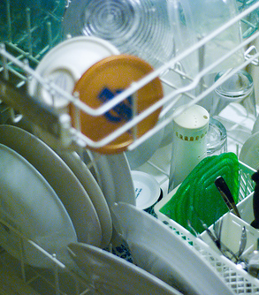
ENERGY STAR TIPS
REFRIGERATOR
Set at the appropriate temperature. Keep your refrigerator at 35 – 38 degrees Fahrenheit.
Allow air to circulate behind the fridge. Leave a few inches between the wall and the refrigerator.
Check the door seals. Make sure the refrigerator seals around the door are airtight. If not sealing tightly, contact management.
DISHWASHER
Scrape, don’t rinse. Rinsing dishes can use up to 20 gallons of water before dishes are even loaded. Your Energy Star dishwasher and HE detergent are designed to do the cleaning so you don’t have to.
Load it up. Dishwashers use about the same amount of energy regardless of load size, so run full loads whenever possible.
Skip the heat. Select the no-heat drying option. It provides good drying results with less energy.
ENTERPRISE RESIDENT HANDBOOK • 25
Notes:
How to use this page:
Delete or update any tips that are irrelevant or need changed.
Consider getting input from: Property Management and Maintenance

Slide 26
ENERGY
ENERGY CONSERVATION TIPS
Lights contribute a significant percentage of electricity use in your home. Replacing incandescent bulbs with high-efficiency CFLs or LEDs reduces electricity use and saves up to $45/month. If done in every household in the U.S. it would reduce greenhouse emissions equivalent to taking 10 million cars off the road.
USE CFL OR LED LIGHT BULBS
Use high-efficiency bulbs and reduce energy us by up to 80%
TURN OFF/UNPLUG APPLIANCES
Unplug when not in use. For example, TV, DVR, fans and coffee maker.
TURN LIGHTS OFF
Turn the lights out when you leave a room and use natural light over electric lights when possible.
KEEP REFRIGERATOR CLOSED
Think about what you need prior to opening the fridge to minimize time spent with the door open.
USE POWER STRIPS
It’s easier to turn off/unplug all appliances at the same time and remove “phantom/ vampire” energy loads.
UNPLUG CELLPHONE/ LAPTOP CHARGERS
These use energy even when the electronic is not being charged. This is called a “vampire” or “phantom” load.
ENTERPRISE RESIDENT HANDBOOK • 26
Notes:
How to use this page:
No adjustment needed
Consider getting input from: the design team on which types of bulbs are most appropriate for the resident’s fixtures;
Change/include additional tips as needed if efficiency features such as smart strips or kill switches are included in the unit.

Slide 27
ENERGY
HEATING SYSTEM GUIDELINES
Your home’s heating system has been designed to reduce the impact on the environment, save energy, and be comfortable…. Explain how heating system works here (type of heating, where air comes out, how to turn on/off and adjust).
Insert information on who will maintain the equipment and note the resident role vs. management role.
One of the best ways to stay comfortable in your home and use less energy is to use your thermostat’s programmable settings. In the winter, you can program it to automatically turn up the heat while you get ready in the morning, turn it down while you’re away, turn it back up in the evening, and turn it down when you go to sleep. This is a great energy saving feature. If your thermostat needs resetting or readjusting, please contact management. Rather than disabling the programming feature, ask for help.
Do not try to use the thermostat as an accelerator to ramp up heat quickly as this causes unnecessary demand on the equipment and wastes a lot of energy. Add additional instructions or care guidelines here.
NEVER use your oven to heat your home and try to eliminate the use of space heaters. These can release carbon monoxide (a deadly toxin), pose a fire hazard, and are expensive to run. If you are uncomfortable in your home, please contact management (insert phone number).
Heating and cooling our homes accounts for almost HALF of the energy use in the average American home. – US Department of Energy (DOE) 2014
ENTERPRISE RESIDENT HANDBOOK • 27
Notes:
How to use this page:
Add details on how the heating system works (i.e. whole building system controlled by thermostat, through the wall PTAC units with control on unit, baseboard controls, etc…) .
Include information on what is the role of the resident regarding their heating/cooling equipment vs. that of Management’s
If a thermostat is used, explain in detail how to set, control, and program it as needed. Thermostat use is often the most confusing feature of a resident’s home and requires thorough explanation and direction. Include images as needed.
Consider getting input from: Property Management, Maintenance, and the Design Team.

Slide 28
ENERGY
HEATING SYSTEM TIPS
Please DO NOT use portable heaters as they are a fire hazard and are very energy intensive. Instead, dress warmly and let sunlight into your home. Close doors to rooms that are not being used to help contain the heat. Keep all heating vents clear of obstruction to ensure heat can enter the room.
KEEP WINDOWS CLOSED
Heating your home while allowing cool air in and hot air out wastes energy.
SEAL LEAKS
If you think you have an air leak, contact management to get it fixed. This improves energy and keeps you comfortable.
OPEN CURTAINS
Allowing the sun to warm your home reduces the demand on your heating (and lighting) system.
USE BLANKETS AND DRESS WARMLY
Using blankets and wearing layers cuts down on the need to turn up the thermostat.
ENTERPRISE RESIDENT HANDBOOK • 28
Notes:
How to use this page:
- No adjustments needed

Slide 29
ENERGY
COOLING SYSTEM GUIDELINES & TIPS
Explain how cooling system works here (type of cooling, where cool air comes out, and how to turn on/off and adjust)
The heating and cooling of your home is a maintained by the same thermostat. See Page X for more on thermostat usage.
Cooling your home uses a lot of energy in the summer months. Ensure your comfort and efficiency by following these tips:
CLOSE WINDOWS WHEN THE AC IS ON
Letting cold air out and hot air in wastes energy.
CLOSE CURTAINS
In the summer months, stay cooler during the day by keeping the sun from heating your home.
SET THE AC TEMP AT 78 DEGREES OR MEDIUM
During cool nights, open windows and turn the AC off or turn the thermostat up a few degrees.
USE A FAN
Instead of (or in addition to) turning on the AC, use a ceiling, window, or portable fan to keep air cool.
The amount of energy consumed in the U.S. every year to power our air conditioners is about the same as the amount of energy consumed by the entire continent of Africa. – Stan Cox, University of Yale 2012
ENTERPRISE RESIDENT HANDBOOK • 29
Notes:
How to use this page:
Add details on how the cooling system works (i.e. whole building system controlled by thermostat, through the wall PTAC units with control on the unit, window A/C,, etc…) .
Insert page number that they should be referring to in order to gain information on the thermostat (“Heating System Guidelines”)
Adjust the temperature outline on the thermostat tip to reflect the degrees or settings in relation to your building
Consider getting input from : Property Management and Maintenance

Slide 30
WATER SMART
SAVING WATER IN YOUR HOME
Water is one of the Earth’s most valuable resources, yet many of us don’t take the time to think about where our water comes from. In fact, every year the number of states in drought grows and fresh water is becoming scarce. Less than 3% of the water on Earth can be used for drinking and only 0.5% is readily available.
For these reasons, your home has been designed with
high-efficiency water fixtures to help conserve this
precious resource.
AVERAGE FIXTURE
YOUR FIXTURE
YOU SAVE
Showerhead
2.5 gallons/min
1.5 gallons/min
Bathroom Faucet
2.2 gallons/min
0.5 gallons/min
Kitchen Sink
2.2 gallons/min
1.5 gallons/min
2,975
gallons
Toilet
1.6 gallons/flush
1.28 gallons/flush
Dishwasher
10 gallons/cycle
5.8 gallons or less
Washing Machine
23 gallons/wash
15 gallons or less
EVERY YEAR!
You may notice that your kitchen and bathroom sinks have a lower flow. This helps to greatly reduce excess water being wasted and to save on utility bills.
The dishwashers and washing machines in the building have a shorter/eco cycle setting to help reduce water consumption as well. Whenever possible, choose to conserve!
The average person uses 80-100 gallons of water each day! That’s over 31,000 gallons per year! – US Geological Survey, 2015
ENTERPRISE RESIDENT HANDBOOK • 30
Notes:
How to use this page:
Update the water fixtures in your building under the “YOUR FIXTURE” section to those actually utilized in the building.
The 2,975 gallons of water savings is a conservative number and projects should achieve this based on the fixtures required for all EGC projects to install and based on average household and usage numbers. If the projects install even higher efficient water fixtures than the one’s listed here, savings will increase from this.
Include any additional instructions on water fixtures, such as information if there is dual-flush toilets or metered sinks.
Consider getting input from: the Design Team (specifically the sustainability consultant and or plumbing engineer) as well as maintenance.

Slide 31

WATER SMART
GREYWATER & RAINWATER REUSE
Rainwater and greywater reuse reduces the demand on water and wastewater processes. This is done by taking non-toxic greywater (that has been semi-treated) and reusing it in situations where water is needed but not for human consumption (such as with irrigation or toilet water). Water reuse is also an important resiliency strategy, as it offers some level of protection against drought and loss of water supply.
The storm water system for this building has been designed to capture rain water that falls on the roof to be used XXX
The plumbing system in this building has been designed to reuse “greywater” to XXX
Though this water is not toxic, it can be harmful if ingested. It is important that you do not use any water that does not come from your sink or shower for drinking, cooking, or bathing.
For this reason, it is also necessary that you do not flush pesticides, toxins, or other harmful chemicals down the shower or bathroom sinks. These items should be disposed of properly through our hazardous waste program.
ENTERPRISE RESIDENT HANDBOOK • 31
Notes:
How to use this page:
If you do have a greywater or rainwater system in the building, add more details on how the system functions, what the water is being “reused” for, what the rules are around its use and any other guidelines.
If there is no greywater or rainwater system in the building, you can delete this slide.
Consider getting input from: the Design Team (most notably the Plumbing Engineer and Architect) as well as Maintenance.

Slide 32
WATER SMART
WATER CONSERVATION TIPS
It takes lots of energy to pump, treat, and heat water so saving water reduces greenhouse gas emissions and can protect this necessary resource. Saving water around the home can be simple by following these steps:
TURN OFF WATER WHEN NOT IN USE
Turn off water while you brush your teeth, shave your face, and wash your hands.
WASH FULL LOADS
A full load of laundry uses less water than two half loads.
DO NOT FLUSH GARBAGE
Never use the toilet as a wastebasket. Save water and prevent blockages by disposing of waste properly.
REFRIGERATE DRINKING WATER
Don’t run water to wait for it to get cold. Fill up a labeled bottle and put it in the fridge.
RECYCLE WATER AROUND THE HOUSE
For example, you can collect water used to wash fruits and veggies for watering house plants.
TAKE SHORTER SHOWERS AND FEWER BATHS
Showers typically use less water. Shortening your shower even by 1 minute can save over 500 gallons per year.
FIX DRIPPING FAUCETS AND RUNNING TOILETS
If you notice an issue with your plumbing, notify management right away.
ENTERPRISE RESIDENT HANDBOOK • 32
Notes:
How to use this page:
- No adjustment needed

Slide 33
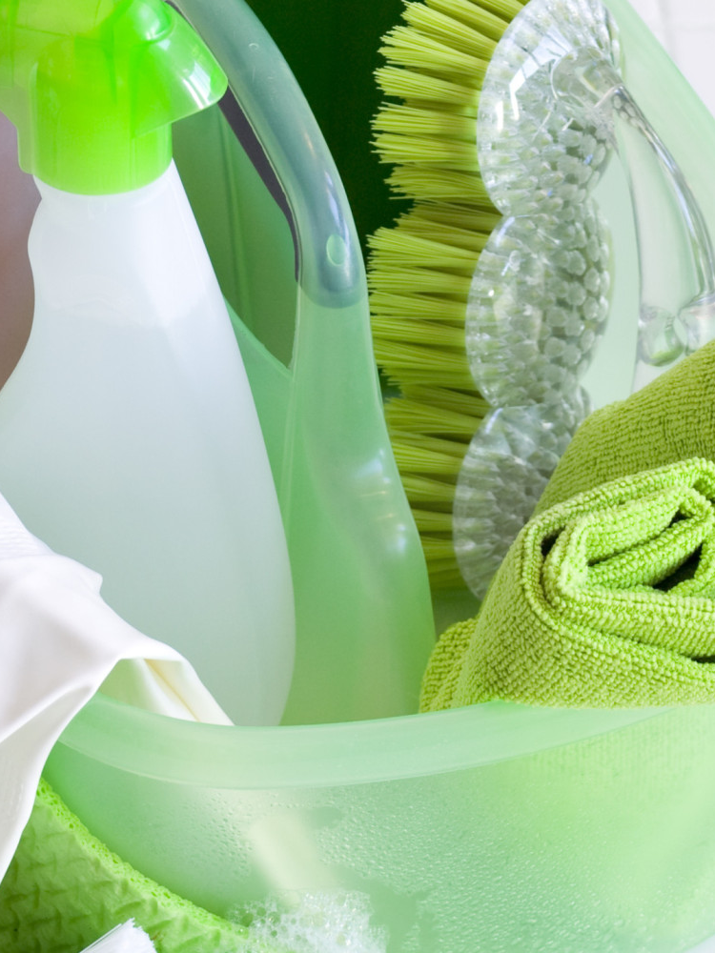

Slide 34
WASTE
RECYCLING AND WASTE MANAGEMENT
Waste that we throw away, chemicals that we pour down drains, and items that we do not recycle all harm our planet. Waste is a major factor in the pollution of our soils, air, bodies of water, and our forests.
X Apartments works with local waste haulers to provide you with an easy means of reducing the amount of waste you put in the landfill. All trash should be disposed of in the dumpster/trash room/trash chute near X. There are separate bins for recycling and trash available. Please dispose of your waste in the proper location.
Add additional info on composting or waste procedures as needed.
Be sure to rinse out bottles and containers to avoid odors and pests.
RECYCLE THESE ITEMS
Paper
Plastics (marked with #1 - #7)
Aluminum and tin
Cardboard and paperboard
Glass
Phone books
Steel and empty aerosol cans
The average American discards 4.4 pounds of garbage every day. Most of this garbage goes into landfills, where it’s compacted and buried. - EPA, 2014
Recycling just one glass jar saves enough energy to power a CFL for 20 hours. Recycling a stack of paper just three feet high saves one tree.
- Recycle Across America, 2014
ENTERPRISE RESIDENT HANDBOOK • 34
Notes:
How to use this page:
Note in manual where and how residents should dispose of their trash and recycling.
Adjust the items that can be recycled as needed.
Insert a picture of what the recycling bins, trash/recycling shoot, or disposal location looks like if available.
If composting services are provided, include them on this slide as well. If space is limited, you can remove one of the “DID YOU KNOW?” facts.
If there are specific guidelines around waste disposal, consider adding it to this slide or the following.
Consider getting input from: Property Management and Procurement. If waste services are outsourced to an outside vendor, they may have specific guidelines on recyclable items and waste maintenance.

Slide 35
WASTE
ADDITIONAL WAYS TO REDUCE WASTE
Think of other ways to reduce waste such as:
Donating lightly used items to ARC, Disabled Veterans, or other Re-use stores
Giving books to libraries or items that can be used in the classroom to schools
Delivering games and puzzles to senior centers and hospitals
The county has means of recycling electronics to reduce e-waste (TVs, microwaves, chargers, etc.) from going to landfills. For more information, go to: www.website.com
USE A REUSABLE BOTTLE
Each year, billions of plastic water bottles are thrown away.
DO NOT USE DISPOSABLES
Avoid using Styrofoam cups, paper plates, plastic utensils, and single use coffee cups.
USE REUSABLE SHOPPING BAGS
Take your own bag for groceries to help cut down on single use plastic bags.
END JUNK MAIL
Remove yourself from mailing lists. For more information, visit:
www.catalogchoice.org
REUSE/RECYCLE
Think twice before putting something in the trash. Decide if there is a better way to dispose of or reuse the item.
ENTERPRISE RESIDENT HANDBOOK • 35
Notes:
How to use this page:
Adjust the slide to reflect information relevant to your county or city.
Insert information on where individuals can recycle e-waste, such as city pick-ups, on-site collections, etc. If there is website to find more information on local e-waste guidelines, you can include it here.
Add any additional tips you may have for reducing waste.
Consider getting input from: Property Management

Slide 36

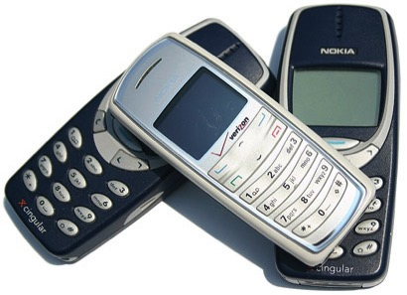





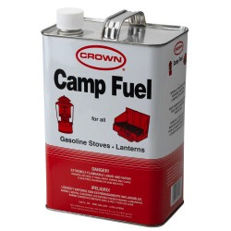

WASTE
RECOGNIZE HAZARDOUS WASTE
Be smart about hazardous waste. It can threaten human health and contaminate the air, water, and soil. It is important to dispose of these items properly. Contact management for assistance with disposal of these products.
For collection / drop-off information, please visit…
BATTERIES & ANTIFREEZE
TVs, CELL PHONES & ELECTRONICS
FLOURESCENT LAMPS & LIGHT BULBS
PAINT & PAINT PRODUCTS
AEROSOL CANS, POOL CHEMICALS & HOUSEHOLD CLEANERS
MEDICATIONS, MERCURY THERMOMETERS & THERMOSTATS
PESTICIDES, HERBICIDES & CHEMICAL FERTILIZERS
COMPUTERS, PRINTERS & PRINTER CARTRIDGES
CAMPING FUEL
ENTERPRISE RESIDENT HANDBOOK • 36
Notes:
How to use this page:
Provide information specific to your building on hazardous waste collection and disposal.
If there is a nearby collection/drop-off location, include their website or contact information here.
If your building has an advanced recycling program, such as for batteries or fluorescent light bulbs, consider adding the information here.
Consider getting input from: Property Management

Slide 37
GREEN SPACE
CONTRIBTUE TO GREEN SPACE
Green space is essential to the health of our planet. Plants help clean the air we breathe, absorb greenhouse gases, provide habitat for wildlife, maintain diversity, and reduce the hot temperatures in the summer.
You can help maintain our community’s green space by adhering to the following guidelines:
1. PICK UP LITTER Litter attracts pests, is harmful to wildlife, and leads to more crime. Help keep our community space beautiful and clean.
2. LEAVE THE PLANTS IN PLACE Do not pick or trample plants and flowers. The landscaping is intended for all to enjoy and leaving them alone keeps them healthy and thriving. Also, the more plants and vegetation we have, the safer the neighborhood is.
3. PICK UP DOG WASTE Keep green space enjoyable for everyone and dispose of pet waste properly.
4. KEEP THE COMMUNITY SPACES FREE OF PERSONAL ITEMS The non-personal community spaces both inside and outside are for use by all residents. Contribute to their maintenance and upkeep by keeping personal items in your own homes.
5. GET INVOLVED Help with local cleanup projects, urban gardening, spreading the word, and simply spending time outside.
Researchers found that residents whose apartments were exposed to green spaces reported fewer aggressive conflicts, including domestic violence, than those who had no views of green space. They also procrastinated less on major goals, like finding a job or new home and were less likely to think their problems were unsolvable. – Kuo, Journal of Environment and Behavior 2011
ENTERPRISE RESIDENT HANDBOOK • 37
Notes:
How to use this page:
Review the guidelines and adjust as needed to reflect your property. For example, if dogs are not allowed on the property, remove point number 3.
If there is a site beautification team, include their information and how to get involved here.
Consider getting input from: Property Management and/or the Service Coordinator

Slide 38
GREEN CLEANING
THE RIGHT PRODUCTS FOR YOU
How can you tell if a product is sustainable and healthy?
“Green” cleaning products have specific ingredients that help to create a healthier indoor environment and reduce outdoor smog by avoiding volatile organic compounds (VOCs).
SELECT PRODUCTS LABELED
AVOID PRODUCTS LABELED
Unscented
Concentrated
Biodegradable
Non-toxic
Low or no-VOC
Phosphate Free
GreenSeal Certified
Design for the Environment
Anti-bacterial
Anti-microbial
Highly flammable or combustible
Danger
Poison
Corrosive
Caution
Never use chlorine bleach or ammonia
The way you clean also matters. Follow these best practices:
Sweep and mop the floors of your apartment at least 1x/week
Vacuum the carpet regularly
Wash dirty dishes and kitchen surfaces daily
Wipe up spills immediately
Clean discolored surfaces or cracked grout with baking soda or borax. If discoloration persists or gets worse, contact Management
Open windows to let fresh air in when the heat and A/C is off
Clean your stove’s range hood and grease filter
Avoid using bristly cleaning brushes and abrasive products
Regularly replace sponges and cleaning rags
Don’t mix cleaning products
Dispose of chemical products properly
ENTERPRISE RESIDENT HANDBOOK • 38
Notes:
How to use this page:
Review the information and adjust as it is relevant to your property.
Consider getting input from: Property Management and Maintenance. Review with the on-site cleaning staff or cleaning vendor to ensure these same product guidelines are being used in the common spaces.

Slide 39
DO IT YOURSELF
EASY RECIPES FOR HOUSEHOLD CLEANERS
BASIC WINDOW CLEANER
¼ Cup white vinegar
Water
Pour white vinegar in a spray bottle and fill to top with water. Spray on surface and wipe with clean sheets of newspaper.
ALL-PURPOSE SPRAY
2 Tbsp. white vinegar
½ Tsp. liquid dish soap
1 Tbsp. baking soda
2 Cups warm water
Combine vinegar and soap in spray bottle. Add baking soda and wait until foaming stops. Add water and shake to mix. Spray and let sit before wiping with a clean rag.
PEPPERMINT FLOOR CLEANER
¼ Cup Murphy’s Oil Soap
1 Cup white vinegar or lemon juice
1 Cup very strong peppermint tea
Combine ingredients in a bucket of warm water and mix until sudsy.
Scrub floor with mop or rag. Follow with a clean water rinse.
TOILET BOWL CLEANER
Sprinkle baking soda inside bowl
Squeeze in a few drops of Murphy’s Oil Soap or Castile Soap
Scrub toilet with a bowl brush and finish outside surfaces with a rag sprinkled with baking soda.
Rinse well with clean water.
Cut out the above green cleaning recipes and post on your refrigerator!
ENTERPRISE RESIDENT HANDBOOK • 39
Notes:
How to use these page:
Review the suggested recipes provided here and additional recipes below (in the notes) on which cleaners will be most relevant and useful to your residents.
Consider testing out a few of the recipes to see how they work in your environment as different types of dusts and pollutants work better with different products (as is true of all cleaners).
Consider getting input from: Service Coordinators or a local non-profit with expertise in green cleaning
CUSTOM ACTIONS: To include additional customized recipes (below): create a new card for the customized actions using the template layouts or the modifiable layout at the end of the presentation.
Toilet Bowl Cleaner (best if you shut off valve to toilet and reduce water in bowl while cleaning)
Sprinkle baking soda inside the bowl. Squeeze a couple of drops of Murphy’s Oil or Castile Soap in also. Scrub with a toilet bowl brush and finish outside surfaces with a rag sprinkled with baking soda. Rinse well with clean water.
Drain Cleaner
Fill a large pot or tea kettle with water and bring to a boil.
Put 1 cup baking soda down drain, then 1 cup white vinegar.
It will bubble and fizz.
After 3-5 minutes, flush drain with boiling water.
Repeat as necessary until drain runs clear.
Baking Soda Oven/Microwave Cleaner
Baking soda
Water
Sprinkle the oven with baking soda after spraying with water. Let it sit for several hours or overnight; scrape up stains and spills. Be sure to thoroughly wipe down with hot water.
Vinegar or Citrus Oven/Microwave Cleaner
White vinegar OR lemons/oranges
Water
Fill a shallow pan with about 1 inch of white vinegar and let sit in oven/microwave overnight. In the morning, use the vinegar and hot water to wipe off all grease and grime.
If you use cut up lemons/oranges, fill the shallow pan with water and put 2-3 cut up citrus fruit in water. Set the pan in oven/microwave and heat to boil. Let sit overnight. In the morning, wipe down with hot water.
Mold and Mildew Treatment
A spray made from one drop of tea tree oil to one cup of water will help clean up most mold and mildew problems. Keep the solution handy in a spray bottle—it should last for months.
A simple vinegar spray (1/2 cup distilled white vinegar to one cup water) is also effective and has a less intense scent.
Wall and/or General Heavy Duty Wash
Use washing soda (sodium carbonate) instead of TSP to wash heavily stained walls. Washing soda is in the same family as baking soda but it is much more caustic/alkaline. It is available in the laundry section of supermarkets. For general heavy duty cleaning, mix 2 tablespoons of washing soda with 2 cups of hot water. Wash dirty areas with a sponge, let dry and rinse. USE GLOVES as this is a very strong cleaner.
Tub and Sink Cleaner
Use baking soda in place of scouring powder. Sprinkle baking soda on porcelain fixtures and rub with a wet rag. Add Castile Soap or Murphy’s Oil Soap to the rag for more cleaning power. Rinse well with clean water.
Green Cleaning Recipes courtesy of: City of Seattle SeaGreen Resident Guide for Living Well http://seattle.gov/housing/SeaGreen/residentguide.htm

Slide 40

PEST MANAGEMENT
PREVENTION TIPS
Pests can carry disease. If you find bugs, ants, rodents, or other pests in your apartment, report it to management (insert phone number) immediately. Pests are often not a sign of “dirtiness” and are something that can happen to any of us.
If you do find pests, please use non-toxic pesticide products and avoid those products that are dangerous to your health, such as Raid spray and Moth Balls. Most pesticides are poisons, and they are often poisonous to humans, as well as to pests. Studies have linked some pesticides to cancer, birth defects, neurological disorders, and immune system disorders, as well as allergies.
Non-toxic solutions (such as sprinkling borax), baits and traps should be used prior to more aggressive means.
The best strategy is to keep pests from coming into your apartment in the first place.
Clean up food and spills right away
Clean the kitchen regularly
Sweep the floors regularly
Rise bottles before recycling
Take out garbage and recycling regularly
Minimize clutter and paper piles
Carefully inspect all used furniture before you buy. Most bed bugs are carried into the home on used furniture. If you have bed bugs contact Management ASAP.
ENTERPRISE RESIDENT HANDBOOK • 40
Notes:
How to use this page:
Review the information here and add or adjust any specifics to pest management you have. Most common pest types vary from region to region as well as property to property, so ensure you are providing details as relevant to your building as possible.
If you prefer for residents to not have a role in pest mitigation at all, make note of that here and remove the section on “the best strategy…” (3rd paragraph).
Consider getting input from: Property Management, Maintenance, and your organization’s Pest Management Professional if you outsource the work to a vendor.

Slide 41
HEALTH HAZARDS
MITIGATION AND PREVENTION
Radon
This building has been tested for Radon and there is a mitigation system in place if and when the gas is at a harmful level. Radon is a natural gas in the ground that rises up and can be deadly.
Lead
During the rehab of this building, all lead has been removed. If you suspect there is lead in your home, contact management.
Asbestos
During the rehab of this building, all asbestos was removed. If you suspect there is asbestos in your home, contact management. If the building is pre-1978 and asbestos wasn’t removed, ensure residents know to contact management if ceilings or walls have been damaged and there is potential exposure.
Mold
During the construction of the building, special care was taken to install anti-microbial surfaces and ensure proper water drainage to limit mold and moisture issues. Be sure to check for and report mold, musty smells, or leaks as soon as possible and use your bathroom and kitchen exhaust fans as designed. Moisture damage can quickly lead to asthma and air quality issues as well as damage to the property.
Fire
Smoke detectors have been installed to provide early warning against deadly smoke. Do not dismantle your alarm. If it starts beeping, the batteries need to be replaced. Do so as soon as possible.
Carbon Monoxide
Monitors have been installed to prevent CO poisoning. Carbon Monoxide (CO) is a silent killer. It has no smell, taste, or color. Do not dismantle or unplug your alarm.
At least two times per year test your smoke detector. This is done by pushing the button in the center. Notify Management immediately if the alarm isn’t functioning.
ENTERPRISE RESIDENT HANDBOOK • 41
Notes:
How to use this page:
Review the information and adjust/add/delete as needed. If your building is a new construction, the information on asbestos and lead will be irrelevant.
If there are high radon levels in the building, be sure to let the residents know that it is being properly mitigated.
If there are additional guidelines you’d like residents to take action around (such as fire, mold, and CO), consider adding it here.
Consider getting input from: Property Management and Maintenance as well as the Design Team (specifically the Architect)

Slide 42
HEALTH HAZARDS
NON TOXIC FINISHES
All the paints, coatings, adhesives and sealants used in the building have low/no volatile organic compounds (VOC). In addition, all composite wood products (cabinets, cupboards, countertops, etc…) have no added urea formaldehyde. VOC and formaldehyde are carcinogens that are often found in building finishes.
If needing to use one of these products (sealing furniture, painting, caulking, etc…), please select No/Low VOCs and Urea Formaldehyde Free. The following are good guidelines:
PAINT TYPE MAXIMUM VOC LIMIT
Primers and sealers 100 g/L
Coatings, flats and non-flats 50 g/L
Opaque floor coatings 50 g/L
Rust preventative coatings 100g/L
Clear wood finishes 275 g/L
ENTERPRISE RESIDENT HANDBOOK • 42
Notes:
How to use this page:
- If there are any additional guidelines on products that can be used in the home for maintenance (ex: caulks) or aesthetics (ex: paints), include them here.
If residents are not allowed to utilize these products in their units, remove slide and note this “rule” in the document under policies or in the lease.
Consider getting input from: Property Management

Slide 43
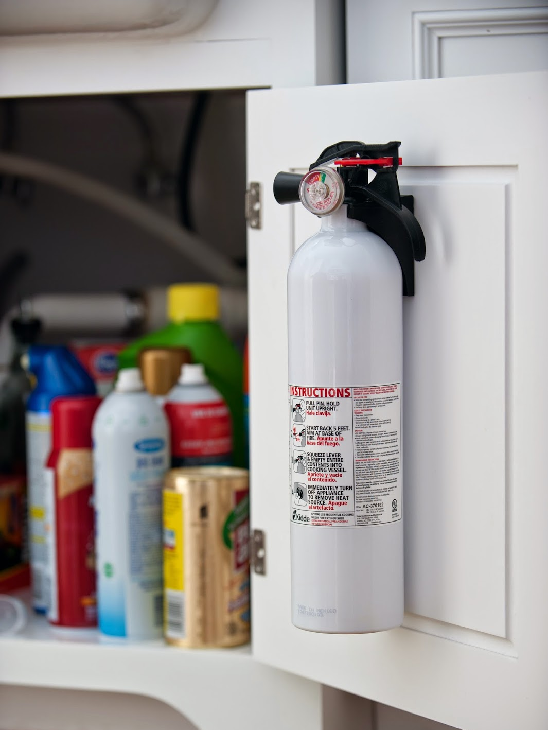

Slide 44
EMERGENCY PLAN
Tornado
When a warning is issued by sirens or other means, seek inside shelter. Consider: (1) Small interior rooms on the lowest floor and without windows, (2) Hallways on the lowest floor away from doors and windows, and (3) Rooms constructed with reinforced concrete, brick, or block with no windows. • Stay away from outside walls and windows. • Use arms to protect head and neck. • Remain sheltered until the tornado threat is announced to be over.
Earthquake
Stay calm and keep away from overhead fixtures, windows, filing cabinets, and electrical power. • Assist people with disabilities in finding a safe place. • Evacuate as instructed by a designated official.
Hurricane
If a hurricane watch has been issued: Stay calm and await instructions from a designated official. • Continue to monitor local TV and radio stations for instructions. • Move out of low-lying areas or from the coast, at the request of officials. • If you are on high ground, away from the coast and plan to stay, secure the building, moving all loose items indoors and boarding up windows and openings. • Collect drinking water in appropriate containers.
If a hurricane warning has been issued: Be ready to evacuate as directed by a designated official. • Leave areas that might be affected by storm tide or stream flooding.
During a hurricane: Remain indoors and consider the following: (1) Small interior rooms on the lowest floor and without windows, (2) Hallways on the lowest floor away from doors and windows, and (3) Rooms constructed with reinforced concrete, brick, or block with no windows.
Stay calm and await instructions from a designated official. • Stay indoors! • If there is no heat: - Close off unneeded rooms or areas. - Stuff towels or rags in cracks under doors. - Cover windows at night. • Eat and drink. Food provides the body with energy and heat. Fluids prevent dehydration. • Wear layers of loose-fitting, light-weight, warm clothing, if available.
Blizzard
ENTERPRISE RESIDENT HANDBOOK • 44
Notes:
How to use this page:
This slide is intended to be used as an introduction to potential weather-related emergencies. Encourage residents to review this information during lease-up and/or at orientation.
Several of the “risks” are location dependent, therefore you’ll want to delete any that do not apply to your region.
Consider getting input from: Property Management and the City’s weather advisory committee on the most recommended emergency action plans.

Slide 45
SITE MAINTENANCE
Personal Items
In order to keep pests away and maintain the beauty of the neighborhood, please keep the sidewalks and public common areas clear of any bicycles, motorcycles, grills, toys, trash, cigarettes, or other personal items.
Patios/
Decks
When cleaning your patio, deck, or sidewalk please sweep it off with a broom rather than using a hose or water. This decreases cracking of the cement and helps to conserve water.
Beautifying
To maintain a nice exterior appearance throughout the community, all window coverings must be approved or furnished by management. No signs, signal, illumination, or advertisements are allowed to be displayed on widows, doors, or any other part of the building. If you wish to hang personal items near your entrance, please contact management for approval first.
Landscape
The plants on this property are either local plants native to the climate and region or plants that survive well in our climate with little need for maintenance. This helps conserve water, provides needed habitat for local wildlife, and limits weed growth. If you would like to plant some of your own plants, please contact management for any guidelines or rules.
Irrigation
The irrigation or lawn watering system was designed to limit water use while ensuring we maintain healthy plants. The plants receive just the amount of water they need through the use of zoned systems, drip irrigation, and a rain sensor. If you notice an issue with the irrigation system, please let management know.
Management
000-000-0000
ENTERPRISE RESIDENT HANDBOOK • 45
Notes:
How to use this page:
The intent of the slides is to briefly outline any recommendations or guidelines regarding exterior site maintenance. Much of this information may overlap with what is outlined in residents’ lease; with that in mind, this can be seen as a quick go-to reference or can be deleted if this overlap is not desired by management.
Review the information, and add/delete/change any information as it relates to your property.
Consider getting input from: Property Management and Maintenance

Slide 46
HOME MAINTENANCE CHECKLIST
SPRING FALL MONTHLY
INTERIOR WALLS, CEILINGS, DOORS
Check for signs of water damage x x
Check operation of windows and doors x
Check for rodents and pests x
PLUMBING FIXTURES AND APPLIANCES
Check and clean refrigerator coils x
Check and clean refrigerator drip pan x
Check plumbing traps and drains x x
Check hot water heater for leaks x
Check bath and kitchen fans x
APPLIANCES
Clean kitchen range hood screens x
Clean dryer vents and screens x
Clean exhaust fan outlets x
Clean A/C coils, drains, pans x
ELECTRICAL AND HVAC
Check smoke and CO alarms x x
Replace air conditioner filters x
Replace dehumidifier filters x
If anything is broken, leaking or needing repair, please contact management (000-000-0000) as soon as possible.
ENTERPRISE RESIDENT HANDBOOK • 46
Notes:
How to use this page:
This slide is intended to give residents a high-level over view of those up-keep/cleaning items that they are responsible for, but don’t take place on a regular/weekly basis.
If any of the items listed here should be handled by management instead of the resident, delete that task. If there are other tasks you find more important or more relevant, you can replace or delete as needed.
Consider getting input from: Maintenance and Property Management

Slide 47
EMERGENCY MAINTENANCE
If you encounter any of these situations, contact management immediately:
Inoperative smoke alarm or carbon monoxide detector
Kitchen sink stopped up
Water leak
Overflowing or broken toilet causing leaks
Stopped up toilet (after plunging failed)
No A/C or Heat
No hot water
Power out
Lightbulb replacement
Gas leak or pilot light out
Wall-mounted sink loose or fallen off the wall
Inoperative stove
Inoperative refrigerator/freezer
Broken first floor window
Broken entrance door lock
Interior and exterior railings loose and/or broken
Banister loose and/or broken
Add more as needed
MAINAGEMENT CONTACT NUMBERS
To Report a Leak or Concern 000-000-0000
To Lean More About How to 000-000-0000
Conserve Resources
Other Comments/Questions 000-000-0000
Thank you for helping to make XXX a healthy and happy community!
ENTERPRISE RESIDENT HANDBOOK • 47
Notes:
How to use this page:
This slide is intended to give residents a list of those item they should contact management immediately for as they pose a health or safety risk.
Review the bulleted points, and add/change/delete as needed.
Insert the recommended phone numbers in the yellow box as they refer to the concern/comment.
Consider getting input from: Maintenance and Property Management

Slide 48
LOCATION OF SYSTEM TURN OFFS
Gas
Located here
Electricity
Located here
Water
Located here
ENTERPRISE RESIDENT HANDBOOK • 48
Notes:
How to use this page:
Provide information on where the system turn offs are for each of the items mentioned in the slide.
If there are other system turn-offs that you would like residents to be aware of, you can add them here.
Consider getting input from: Maintenance and the Design Team (specifically the MEP)

Slide 49
ADDITIONAL POLICIES
Pets
Information here
Noise
Information here
Rent Payment
Information here
Laundry
Information here
Parking
Information here
Lock and Key
Information here
ENTERPRISE RESIDENT HANDBOOK • 49
Notes:
How to use this page:
The intent of the slides is to briefly outline any recommendations or guidelines regarding property policies. Much of this information may overlap with what is outlined in residents’ lease; with that in mind, this can be seen as a quick go-to reference or can be deleted if this overlap is not desired by management.
Review the information, and add/delete/change any information as it relates to your property.
If you have a lot of families with young children on the property as well as a surface parking lot, consider posting signage of speed limits and including speed limit language in this document.
Consider getting input from: Property Management and Maintenance

Slide 50
EMERGENCY EXIT MAP
ENTERPRISE RESIDENT HANDBOOK • 50
Notes:
How to use this page:
Update the map for specific building/complex
Consider including on the map the location of fire alarms, fire extinguishers, and senior designated waiting areas if in a mid/high rise.
This map is duplicated from the one in the beginning of the manual so that residents can quickly reference it when needed and not have to rifle through the pages.

